Slide 1
Introduction to Conversational AI: Build NLU model using LUIS
By Mansi Jain
Alpha Microsoft Learn Student Ambassador

Slide 2

Speaker for today’s session
Computer Science Undergrad at Amity University, Noida.
Alpha Microsoft Learn Student Ambassador.
Data Science & Machine Learning enthusiast.
Mansi Jain
Microsoft Learn Student Ambassador (Alpha)

Slide 3
Topics To Be Discussed
What is Conversational AI?
What is NLU (Natural Language Understanding)?
- Utterances
- Intents
- Entities
What is LUIS (Language Understanding Intelligent Service)?
What does LUIS offer?
Application development life cycle
Demonstration for building NLU model using LUIS.

Slide 4

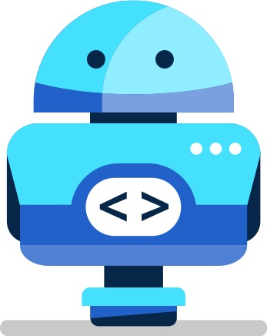
What is Conversational AI?
Conversational AI is a subfield of artificial intelligence focused on producing natural and seamless conversations between humans and computers.
A new user interface paradigm.
Exposes software services through conversational interface.
In apps, browser and on IoT devices.

Slide 5
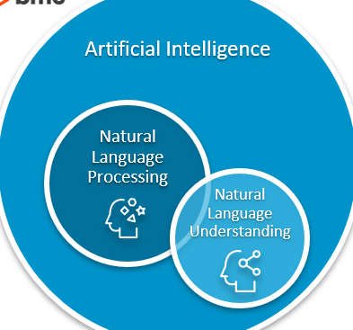
What is Natural Language Understanding (NLU)?
NLU directly enables Human-Computer Interaction (HCI) in the form of dialogues/conversations.
NLU is tasked with communicating with untrained individuals and understanding their intent, and entities meaning that NLU goes beyond understanding words and interprets meaning.
NLU should be programmed with the ability to understand meaning despite common human errors like mispronunciations or transposed letters or words.

Slide 6
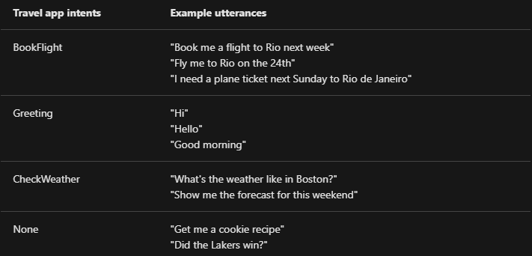
Intents: What does the user want to say?
An intent represents a task or action the user wants to perform. It is a purpose or goal expressed in a user's utterance.
E.g. book a flight, request a vacation, place an order, delete an email, pay a bill etc.
Intents -> Actions users want to take in your application

Slide 7
Utterances: How will users ask for something?
Utterances are input from the user that your app needs to interpret.
To train LUIS to extract intents and entities from them, it's important to capture a variety of different example utterances for each intent.
Active learning, or the process of continuing to train on new utterances, is essential to machine-learning intelligence that LUIS provides.
Example utterances
- How do I get a computer?
- Where do I get a computer?
- I want to get a computer, how do I go about it?
- When can I have a computer?
What good utterances are - http://bit.ly/utterances

Slide 8
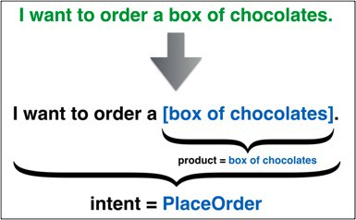
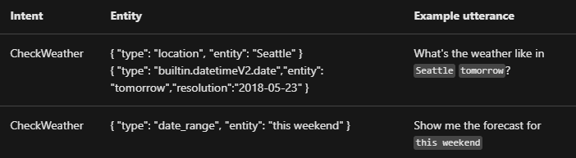
Entities: What information did the user give?
The intent represents action the application should take for the user and is based on the entire utterance. An utterance can have only one top scoring intent but it can have many entities.
Entities -> Represent parameters required to execute the action.
Find me flights from Cairo to Seattle today
OriginCity
DestinationCity
Date

Slide 9


LUIS (Language Understanding Intelligent Service)
LUIS (Language Understanding)- Cognitive Service, Microsoft.
LUIS is a cloud-based conversational AI service that applies custom machine-learning intelligence to a user's conversational, natural language text to predict overall meaning, and pull out relevant, detailed information.
It provides access through its custom portal, APIs and SDK client libraries.

Slide 10




What does LUIS Offer?
Enterprise-ready, available worldwide
Quickly build a custom language solution (Integration)
Simplicity
Always learning and improving
Security, Privacy and Compliance

Slide 11
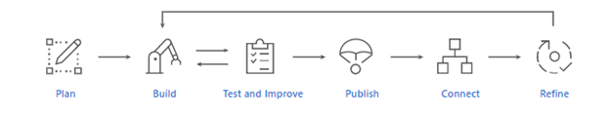
Application Development life cycle

Slide 12
Any Questions?
https://forms.office.com/r/da35uVH3MJ

Slide 13
Thank You :)

